Slide 1
Model – View - View Model Brief Intro
By : Suraj Kulkarni

Slide 2
Project analysis slide 2
Content
Android Architecture
Components
1
Actual Code
3
MVVM
MVVM Overview
Q & A
2
4
Notes:
Android Architecture Components : Android JetPack (May 2018) – Foundation, Architecture, Behavior, UI. – To make android development easier and seamless. Here we will discuss important Architecture components and how they are work together. Will tell you about android JetPack Libraries.
Room Database : * Its is a wrapper for the Underlying SQLite database. * It Reduced time-consuming boilerplate Code. * It reduces SQLite Runtime errors and Syntax errors, * It is compatible with the Live Data (It can return Live Data Object)
Retrofit :
MVVM Overview : In this section I will give you a over view kind of block diagram as to how things work in MVVM.
Low-level Programming : In this section I will demonstrate the actual code how it works with the help of out Krios Champs Application.
Q & A : This section is for all of you. I will try to answer your queries else will get back to you.

Slide 3
Android JetPack
Foundation
Architecture
Behaviour
UI
Data Binding
LifeCycle
LiveData
Navigation
Paging
Room
ViewModel
WorkManager

Slide 4



Project analysis slide 3
Android Architecture
Components
Lifecycle Aware Components
LiveData
ViewModel
Room
DataBinding
LiveData is an observable data holder class. Unlike a regular observable, LiveData is lifecycle-aware, meaning it respects the lifecycle of other app components, such as activities, fragments, or services.
The ViewModel class is designed to store and manage UI-related data in a lifecycle conscious way. The ViewModel class allows data to survive configuration changes such as screen rotations.
The Data Binding Library is a support library that allows you to bind UI components in your layouts to data sources in your app using a declarative format rather than programmatically.
The Room persistence library provides an abstraction layer over SQLite to allow for more robust database access while harnessing the full power of SQLite.
Lifecycle-aware components perform actions in response to a change in the lifecycle status of another component, such as activities and fragments.
Notes:
Android JetPack : Foundation, Architecture, Behavioural, UI
All Components : Navigation, Paging, Work manager.
What is Architecture?
Need of Architecture?
Separation of concerns
Drive UI from a model
Available Architectures : MVC, MVP, MVVM
Why MVVM?
Lifecycle Aware Components : To reduce the amount of code present in Lifecycle Activity Methods./ make code more organise/ reduce chances of application errors and crashes. Avoid Race condition. Avoid memory leaks.
Live Data : Ensures your UI matches your data state * No memory leaks * No crashes due to stopped activities * No more manual lifecycle handling * Always up to date data * Proper configuration changes * Sharing resources

Slide 5
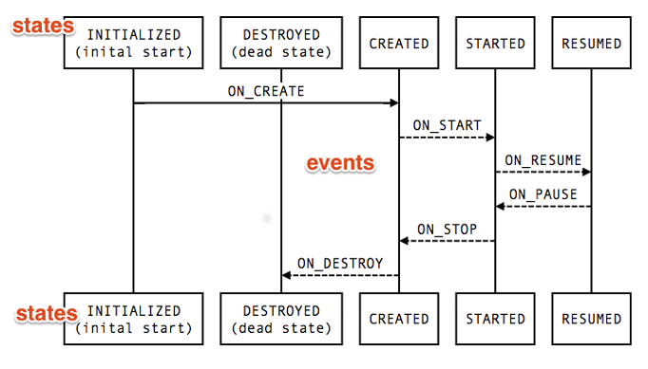
Project analysis slide 4
Lifecycle Aware
Components
Notes:
annotationProcessor "androidx.lifecycle:lifecycle-compiler:2.0.0"
implementation "androidx.lifecycle:lifecycle-extensions:2.1.0-alpha04“
implementation "androidx.lifecycle:lifecycle-extensions:2.0.0“
lifecycleOwner.getLifecycle().addObserver(this);
@OnLifecycleEvent(Lifecycle.Event.ON_CREATE)
new BindingClass(this);

Slide 6
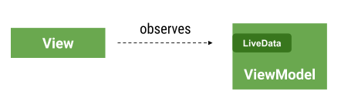
Project analysis slide 4
Live Data

Slide 7
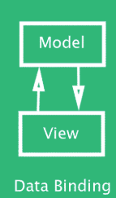
Project analysis slide 6
Data Binding

Slide 8
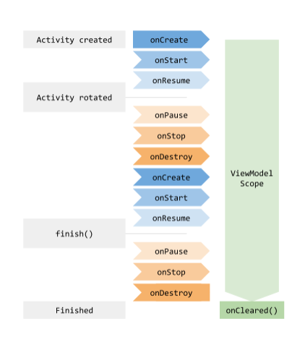
Project analysis slide 5
ViewModel

Slide 9
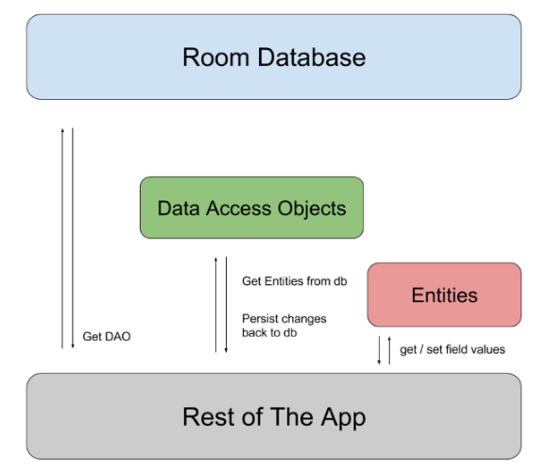
Project analysis slide 6
Room

Slide 10
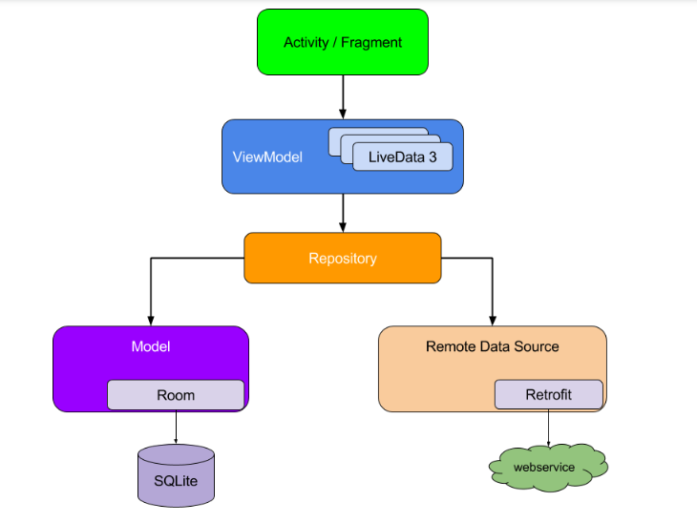
Project analysis slide 6
MVVM Overview

Slide 11

Project analysis slide 10
Q & A

Slide 12
Project analysis slide 10
References
Sr. No. | Concept | Link
1 | JetPack | https://developer.android.com/jetpack
2 | Room Demo | https://codelabs.developers.google.com/codelabs/android-room-with-a-view/index.html?index=..%2F..index#0
3 | DataBinding Demo | https://codelabs.developers.google.com/codelabs/android-databinding/index.html?index=..%2F..index#0
4 | ViewModel, LifeCycle, LiveData Demo | https://codelabs.developers.google.com/codelabs/android-lifecycles/index.html?index=..%2F..index#0
5 | My Demo (SK) | https://github.com/the-kool-sk/AndroidArchitectureComponents_Demo.git
6 | MVVM guide | https://developer.android.com/jetpack/docs/guide

Slide 13
Thank You

